Slide 1
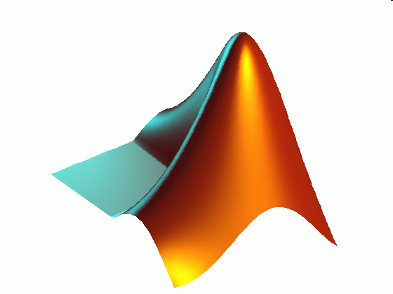
ME 203 Introduction to MATLAB
1

Slide 2

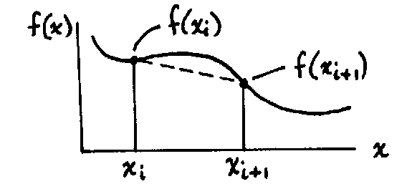
Differentiation
Differentiation is the calculation of the slope of a function. The easiest way to calculate the slope is to take the difference between two points.

Slide 3

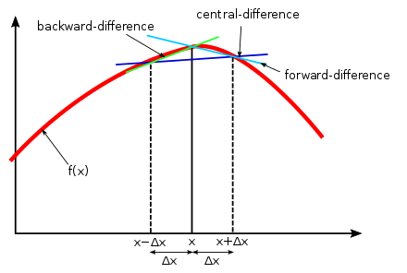

1st order Finite Difference Equations
Backward difference
Forward difference
Central difference
$$f^{′}\left(x_{k}\right)=\frac{f\left(x_{k+1}\right)−f(x_{k−1})}{x_{k+1}−x_{k−1}}$$

Slide 4



1st order Finite Difference Equations
Backward difference
$$f^{′}\left(x_{1}\right)=\frac{f\left(x_{1}\right)−f(x_{0})}{x_{1}−x_{0}}$$
Undefined values
$$f^{′}\left(x_{2}\right)=\frac{f\left(x_{2}\right)−f(x_{1})}{x_{2}−x_{1}}$$
$$f^{′}\left(x_{n}\right)=\frac{f\left(x_{n}\right)−f(x_{n−1})}{x_{n}−x_{n−1}}$$

Slide 5



1st order Finite Difference Equations
Forward difference
$$f^{′}\left(x_{1}\right)=\frac{f\left(x_{2}\right)−f(x_{1})}{x_{2}−x_{1}}$$
$$f^{′}\left(x_{n−1}\right)=\frac{f\left(x_{n}\right)−f(x_{n−1})}{x_{n}−x_{n−1}}$$
Undefined values
$$f^{′}\left(x_{n}\right)=\frac{f\left(x_{n+1}\right)−f(x_{n})}{x_{n+1}−x_{n}}$$

Slide 6



1st order Finite Difference Equations
x = [ 0 1 2]
y = [ 5 4 2]
Find the slope at x = 1, using backward, forward and central difference method.
Consider:
X₀ = 0; y₀=5
X₁ = 1; y₁=4
X₂ = 2; y₂=2
Backward difference
$$f^{′}\left(x_{1}\right)=\frac{f\left(x_{1}\right)−f(x_{0})}{x_{1}−x_{0}}$$
Forward difference
$$f^{′}\left(x_{1}\right)=\frac{f\left(x_{2}\right)−f(x_{1})}{x_{2}−x_{1}}$$
Central difference
$$f^{′}\left(x_{1}\right)=\frac{f\left(x_{2}\right)−f(x_{0})}{x_{2}−x_{0}}$$
Notes:
B = -1, F = -2, C = -1.5

Slide 7
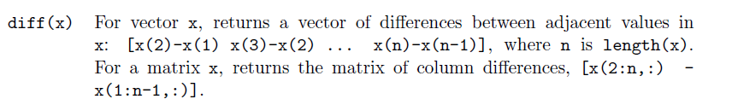
Diff(x)
The diff function computes differences between adjacent values in a vector, generating a new vector with one less value.

Slide 8
Differentiation Example 1
Calculate the derivative for the following set of data using both forward and backward difference methods. Plot the data and the slope for each method.
x = [ 0 1 2 3 4 5 6 7 8 9 10]
y = [ 5 4 2 3 4 7 9 7 6 5 4]
%Differentiation example 1
clc; clear all; format compact
%given
x = 0:10;
y = [5, 4, 2, 3, 4, 7, 9, 7, 6, 5, 4];
%calculate difference
dy = diff(y)
dx = diff(x)
Result for Differences
dy =
-1 -2 1 1 3 2 -2 -1 -1 -1
dx =
1 1 1 1 1 1 1 1 1 1

Slide 9
Differentiation Example 1
%calculate slope
dy_dx = dy./dx
%calculate x values for forward difference plot
xf = x(1:end-1)
%calculate x values for backward difference plot
xb = x(2:end)
Result for slope
dy_dx =
-1 -2 1 1 3 2 -2 -1 -1 -1
xf =
0 1 2 3 4 5 6 7 8 9
xb =
1 2 3 4 5 6 7 8 9 10

Slide 10
Differentiation Example 1
%plot data and slope
plot(x,y,'-ok') %plot data
hold on
plot(xf,dy_dx,'-.r') %plot forward diff
plot(xb,dy_dx,'--b') %plot backward diff
xlabel('x')
legend('data','forward diff','backward diff')

Slide 11
Differentiation Example 1

Slide 12





1st order Finite Difference Equations
Central difference
$$f^{′}\left(x_{k}\right)=\frac{f\left(x_{k+1}\right)−f(x_{k−1})}{x_{k+1}−x_{k−1}}$$
$$f^{′}\left(x_{1}\right)=\frac{f\left(x_{2}\right)−f(x_{0})}{x_{2}−x_{0}}$$
Undefined values
$$f^{′}\left(x_{2}\right)=\frac{f\left(x_{3}\right)−f(x_{1})}{x_{3}−x_{1}}$$
$$f^{′}\left(x_{n−1}\right)=\frac{f\left(x_{n}\right)−f(x_{n−2})}{x_{n}−x_{n−2}}$$
Undefined values
$$f^{′}\left(x_{n}\right)=\frac{f\left(x_{n+1}\right)−f(x_{n−1})}{x_{n+1}−x_{n−1}}$$

Slide 13
Differentiation Example 2
Calculate the derivative for y=sin(x) over the range x=[0 pi] using the central difference method. Plot the function and the slope.
%Differentiation example 1
clc; clear all; format compact
%given
x = linspace(0,pi,50);
y = sin(x);
n = length(x);
%calculate differences
dy = y(3:n) - y(1:n-2);
dx = x(3:n) - x(1:n-2);
%calculate slope
dy_dx = dy./dx;
plot(x,y,x(2:n-1),dy_dx)
legend(‘sin(x)','d(sin(x))/dx')

Slide 14
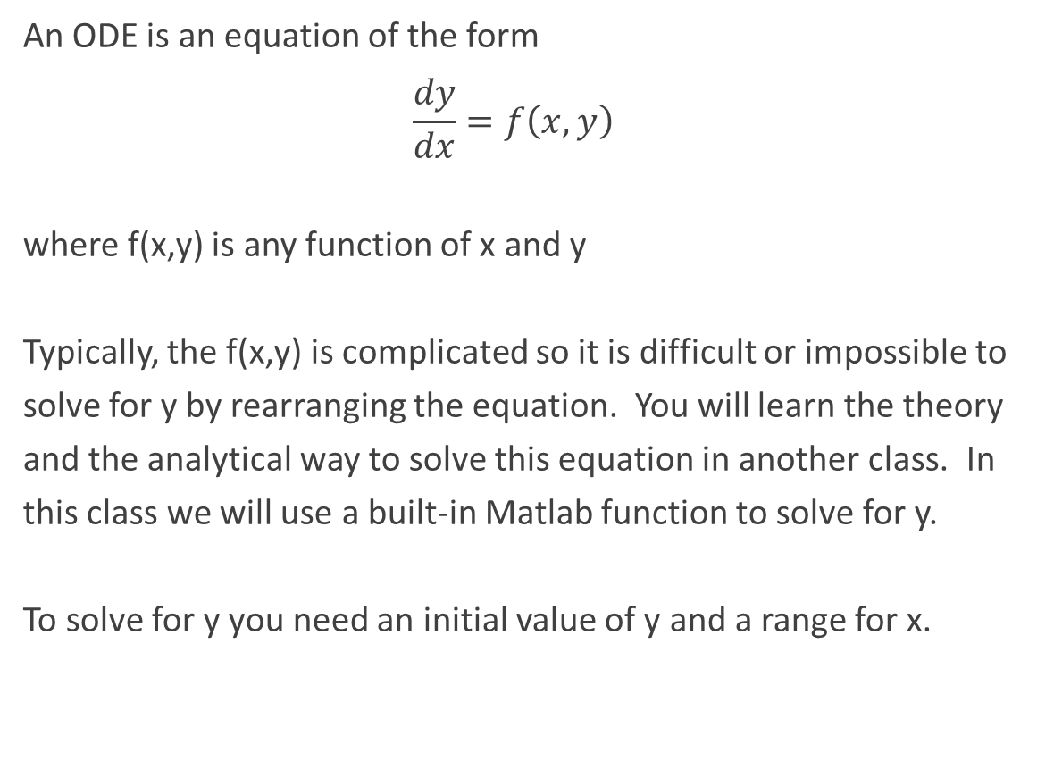
ODEs (Ordinary Differential Equations)
An ODE is an equation of the form
$$\frac{dy}{dx}=f\left(x,y\right)$$
where f(x,y) is any function of x and y
Typically, the f(x,y) is complicated so it is difficult or impossible to solve for y by rearranging the equation. You will learn the theory and the analytical way to solve this equation in another class. In this class we will use a built-in Matlab function to solve for y.
To solve for y you need an initial value of y and a range for x.

Slide 15
ode45
[X, Y]=ode45(@f, [X-range],[Y-initial value])
f: previously defined function whose input arguments are x and y
X-range: initial and final values of the independent variable
Y-initial value: initial value of the dependent variable

Slide 16

ODE Example 1
Solve the ODE
$\frac{dy}{dx}+10y=0$
Use: x=[0, 0.5], y(x=0)=2. Plot the solution.
x-range: 0 to 0.5
Initial value (i.e., when x=0) of y: y(0) = 2
$\frac{dy}{dx}=−10y$
Find: Plot y vs. x

Slide 17
ODE Example 1
Define the function file:
Call the function from another script file or command window:
function dy_dx = odeexample1 (x,y)
dy_dx = -10*y;
end
%ODE example 1
clc, clear all, format compact
%Given
x_range = [0, 0.5];
y_initial = 2;
[x, y] = ode45 (@odeexample1, x_range, y_initial);
plot(x,y)
xlabel('x')
ylabel('y')

Slide 18
ODE Example 1

Slide 19
ODE Example 1
Alternatively, one can use a function handle within the script file instead of defining a separate function file
%ODE example 1 - another method
clc, clear all, format compact
%function handle
fun = @(x,y) -10*y;
[x,y] = ode45 (fun, [0, 0.5], 2);
plot(x,y)
xlabel('x')
ylabel('y')

Slide 20
ODE Example 1
Alternatively, one can use a function handle within the script file instead of defining a separate function file
%ODE example 1 - another method
clc; clear all; format compact
[x,y] = ode45 (@(x,y) -10*y, [0, 0.5], 2);
plot(x,y)
xlabel('x')
ylabel('y')

Slide 21

ODE Example 2
Solve the ODE: $\frac{dy}{dx}=−2y^{3}+x−y$
Given: x=[6, 24], y(x=6)=-3, Find: Plot y vs. x
%ODE example 2
clc; clear all; format compact
%given
x_ran = linspace(6,24,100); %to divide the x range into 100 steps
y_ini = -3;

Slide 22
ODE Example 2
%function handle
fun2 = @(x,y) (-2*y.^3+x-y);
[t,y] = ode45 (fun2, x_ran, y_ini);
plot(t,y), xlabel('t'), ylabel('y')

